Slide 1


Exploring Global Happiness Dataset
By Jefrin

Slide 2
INTRODUCTION
This project aims to analyze a happiness dataset to identify the key factors that contribute to a country's happiness.
The analysis involves data cleaning, preprocessing, and exploratory analysis to discover trends, outliers, and geographical influences.
The findings indicate that wealth, health, and freedom are strong indicators of happiness. Ultimately, the goal is to provide insights for policymakers and researchers on how to improve well-being.

Slide 3
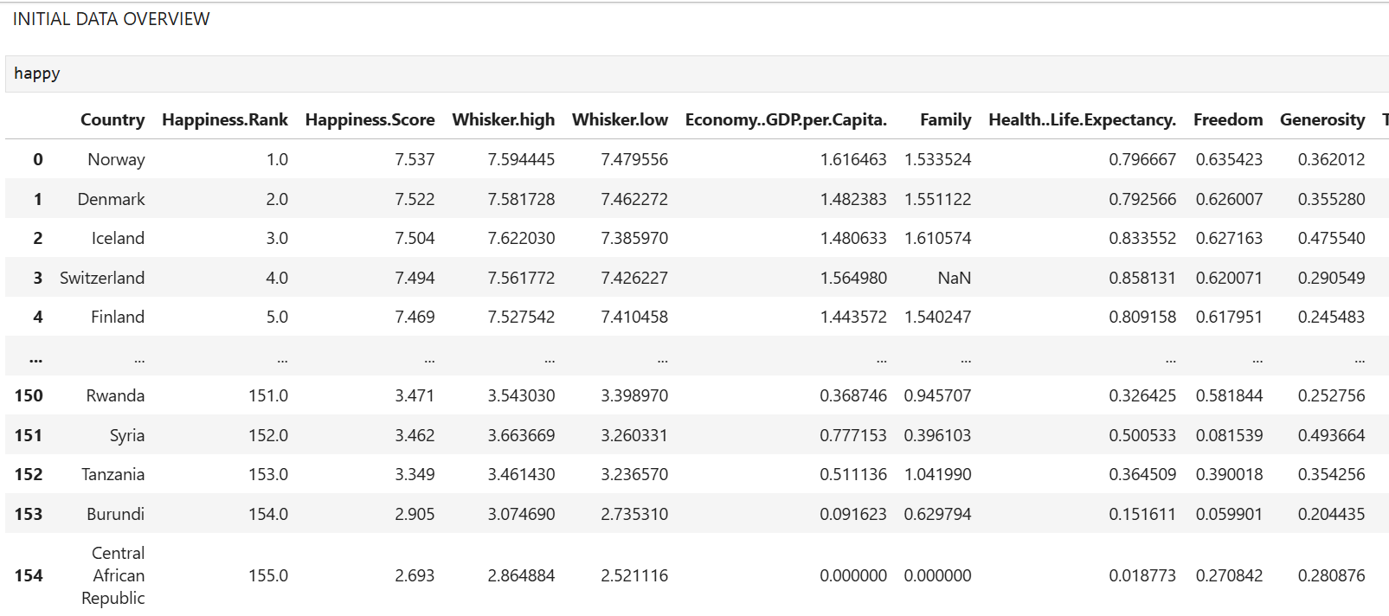
DATASET OVERVIEW

Slide 4
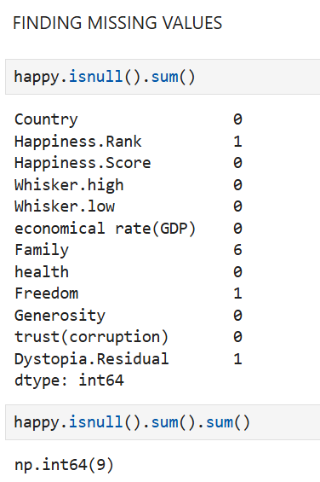
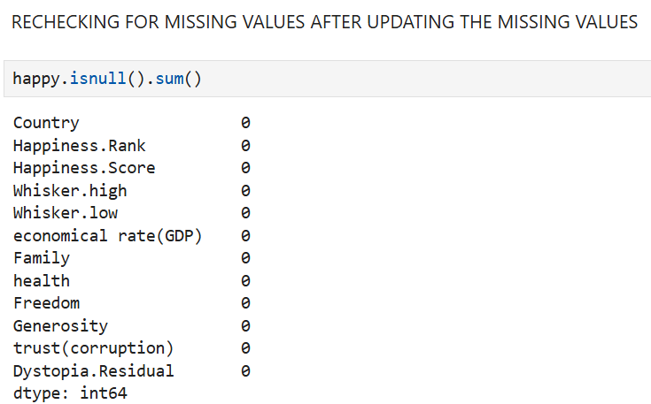
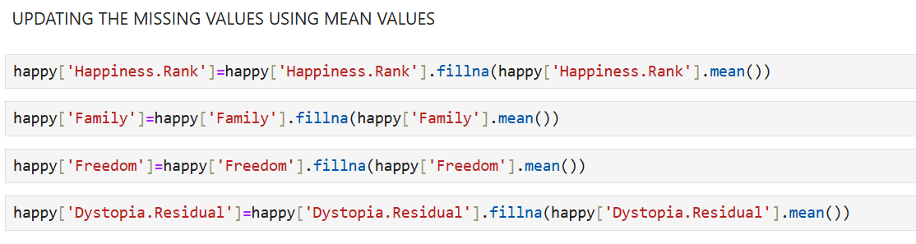
DATA CLEANING

Slide 5

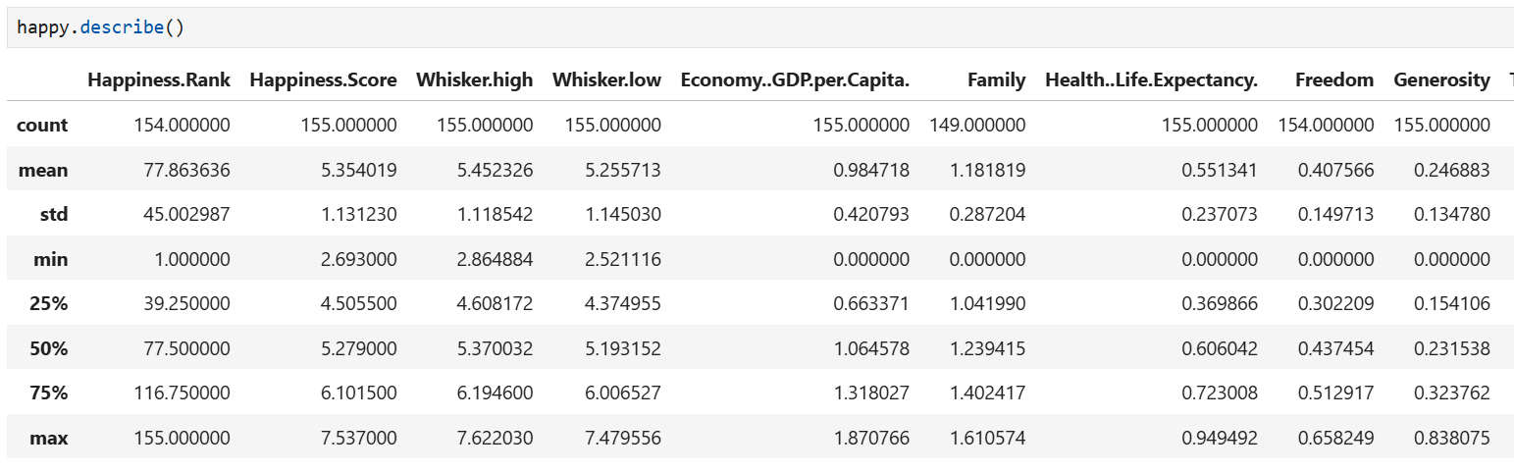
DESCRIPTIVE ANALYSIS

Slide 6
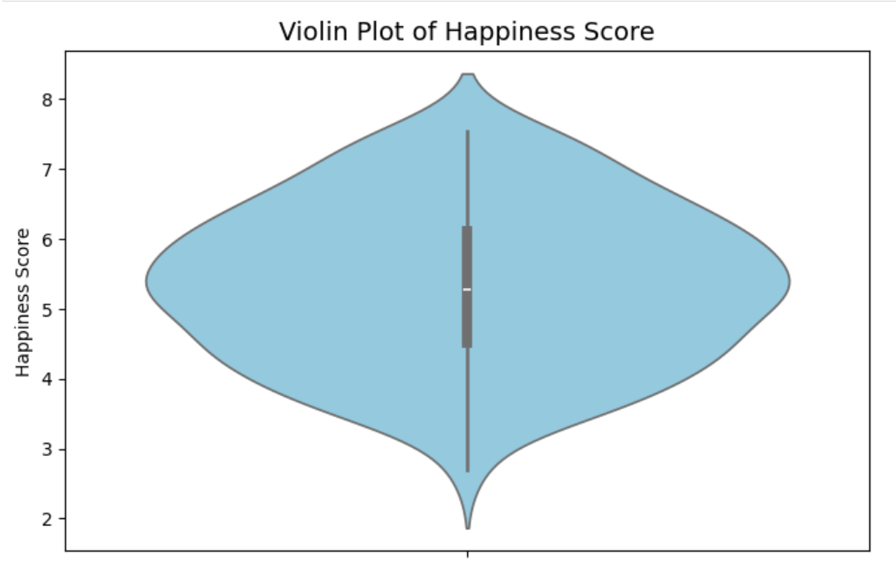
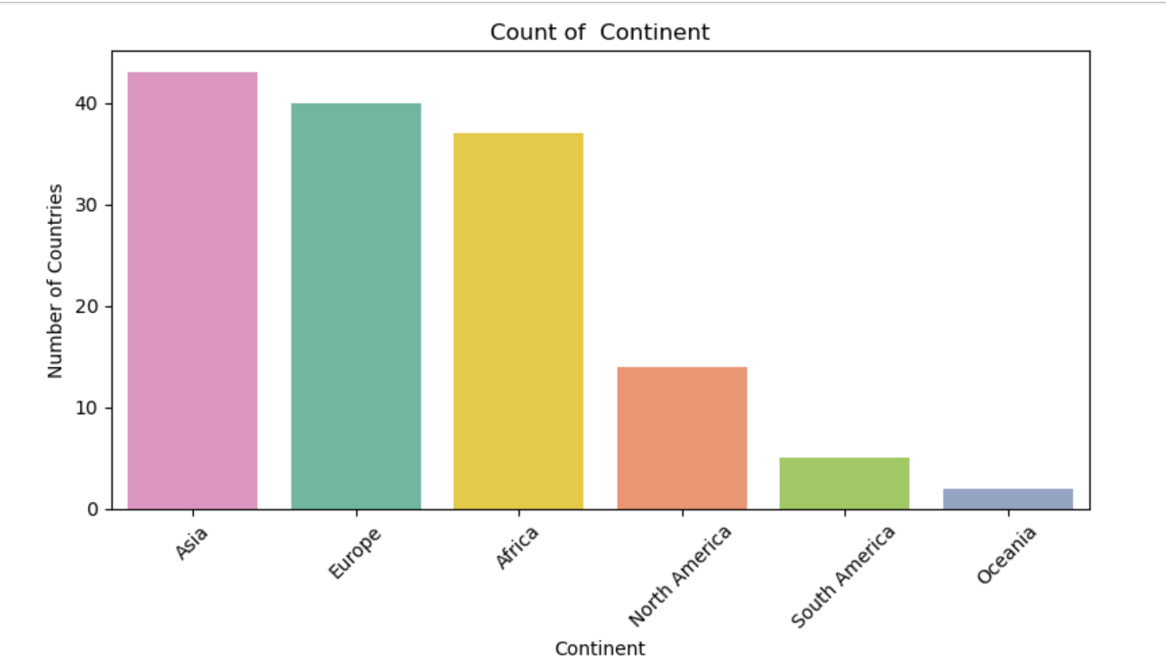
UNIVARIATE ANALYSIS
.

Slide 7
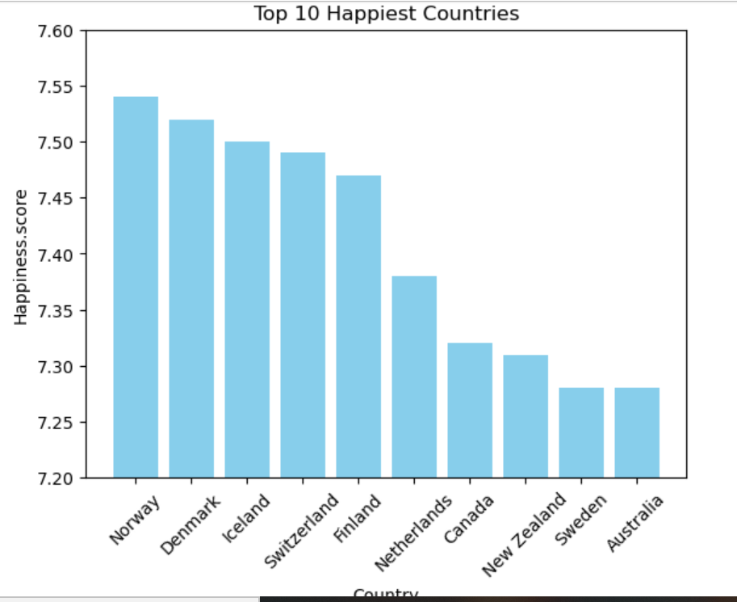
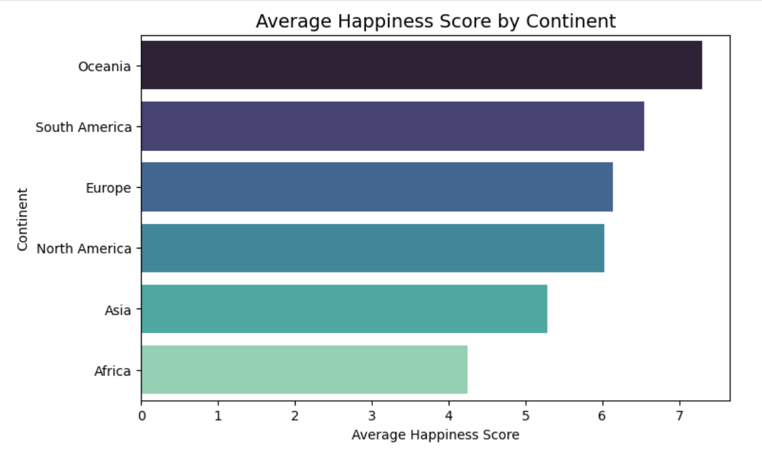
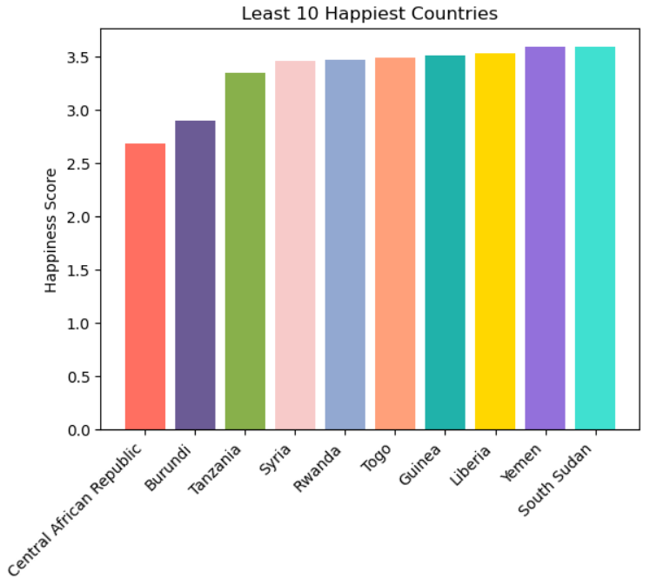
BIVARIATE ANALYSIS
Bar plot for finding
happiest continent
Bar plot for Least 10
Countries
Bar plot for top 10 counties

Slide 8
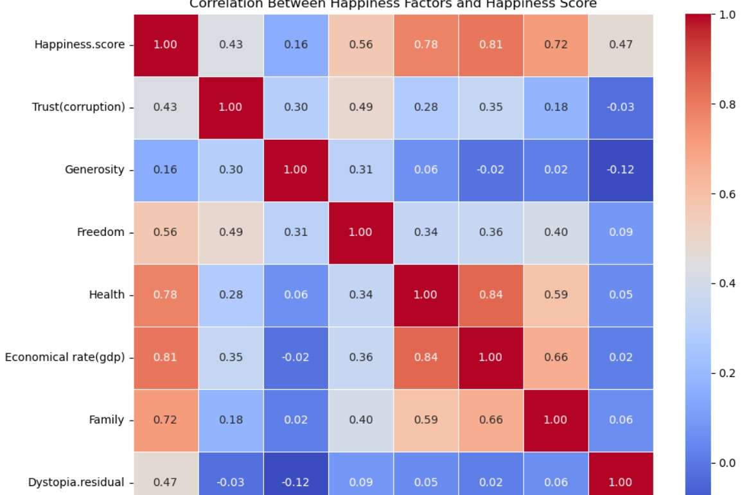
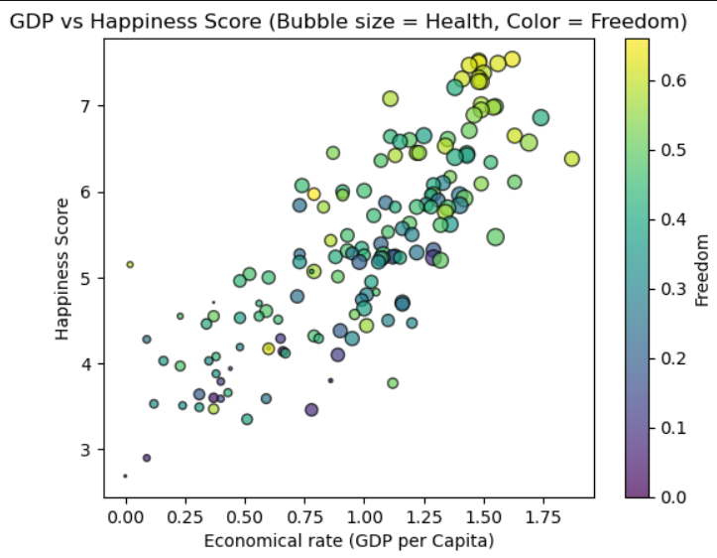
MULTIVARIATE ANALYSIS
Heat Map to find correlation
Scatter plot to find importance of GDP

Slide 9
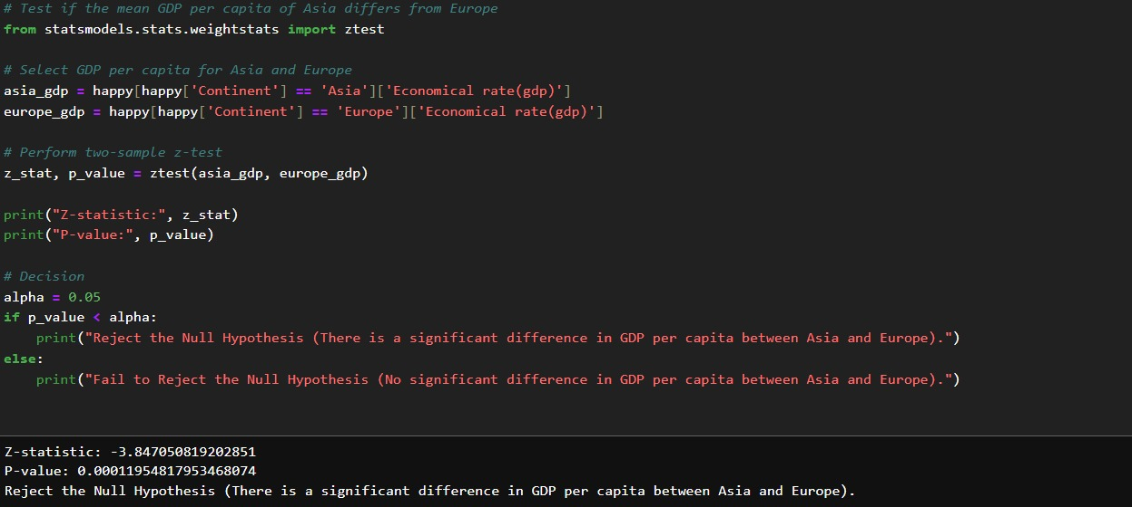
HYPOTHESIS TESTING
Z Test to find the significant difference between GDP and between Europe and Asia

Slide 10
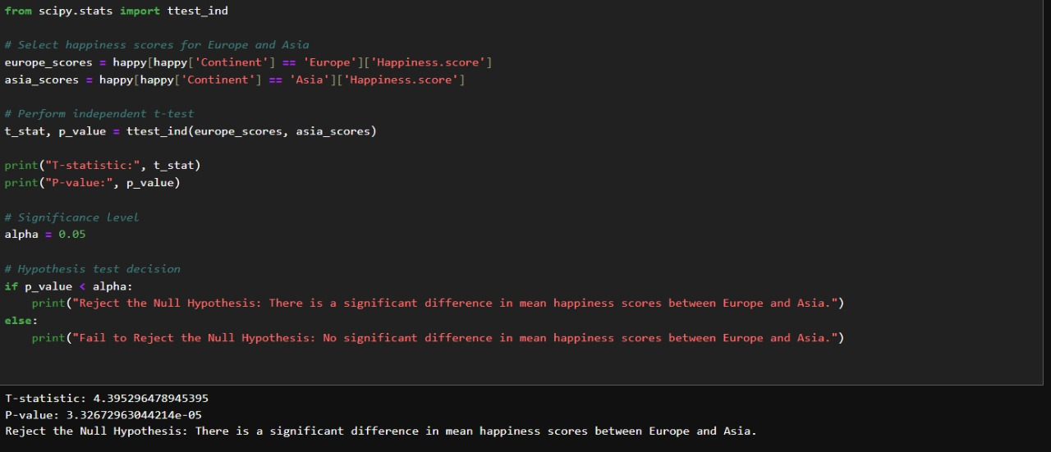
T test to find difference of mean happiness score between Asia and Europe

Slide 11

CONCLUSION
Key Findings:
Wealth, health, and freedom strongly influence happiness.
Countries with lower GDP and weaker health/freedom metrics tend to have lower happiness scores.
Nordic countries, with high GDP, strong social support, and good governance, are consistently happiest.
Recommendations:
Economic development is crucial for improving happiness.
Health systems, social support, and personal freedom are strong non-economic contributors.
Reducing corruption and improving governance can positively impact well-being.

Slide 12

Thank You
-JEFRIN

